Slide 1
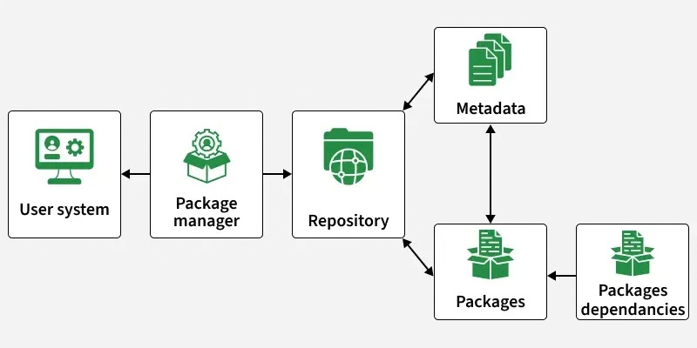
  Package Managers & Dependencies
Imagine I'm building a website and I need a date picker, icons, animations, etc. Am I supposed to write all of that from scratch?"
No.
Someone has already written the code → package/library.
Then:
Package -
A reusable piece of code that someone else has created and published.
examples
lodash, axios, express, react, lucide-react, bootstrap

Slide 2
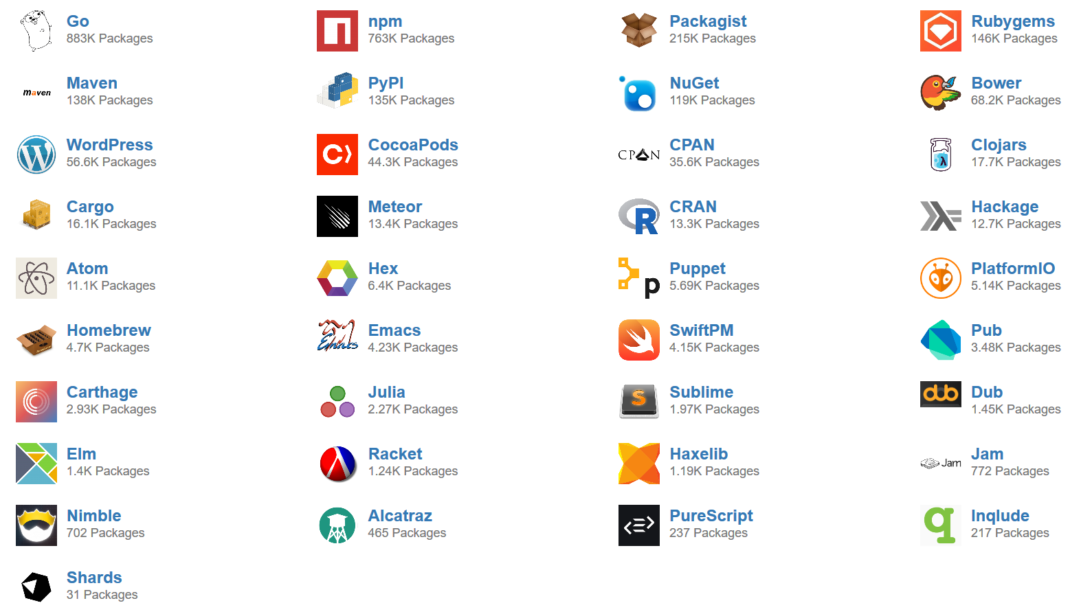
Popular package managers
JavaScript / Node.js: npm , pnpm, Bun
Python: pip
Java: Maven · Gradle
PHP: Composer
Rust: Cargo
.NET / C#: NuGet
Ruby: RubyGems

Slide 3
Node Package manager
Npm is a standard package manager for Node.js
  Liabrary of packages
express.js, react.js etc
  Npm is a command line tool
we can install packages, use them through command lines.
It helps us:
  install packages
  remove packages
  manage package versions
  run project commands
  keep track of dependencies
installation - Preinstalled with Node

Slide 4
Dependancies
A dependency is a package/library that our project needs to work or provide some functionality.
express
↓
Package
↓
Installed in your project
↓
Now it is a Dependency of your project
Package vs Dependency
  Package → reusable code that can be installed.
  Dependency → package that your particular project depends on.

Slide 5

Installing Packages
npm install <- package name->
npmjs.com
Demo 1 - install figlet
search packages
When you install a package using npm, three important files/ folders are involved
  node_modules - Stores the actual installed packages and their dependancies
  package.json - Contains the project details and lists the required dependancies
  package-lock.json - Records the exact versions of installed packages and their dependancy tree i.e its subdependancies and their versions
node modules[delete] ---> dependancies[delete] ---> running code may cause errors ( as req modules such as figlet, cannot be found)
To fix this, we can restore the dependancies ----------> npm install command
Running npm install reads the dependancies listed in package.json and reinstalls them, creating node modules folder again

Slide 6

npm init
npm init is basically “create a new Node.js project here.”
npm init
npm will ask for details like:
  Project name
  Version
  Description
  Entry point
  Author
  License
npm init -y
→ default values are automatically accepted.
npm init tells npm: “This is a new project that I want you to manage.”
↓
It sets up/initializes a project as an npm project so that npm can manage its packages and dependencies.
npm init → initialize project interactively
npm init -y → initialize project with default values automatically

Slide 7


  Styling (CSS in reactjs)
React provides multiple ways to style components:
  CSS Stylesheets
  Inline Styling
  CSS Modules
4

Slide 8
  CSS stylesheets
  Inline styling
  CSS modules
CSS can be written in a separate .css file and imported into the React component.
import "./App.css";
<h1 className="title">Hello</h1>
.title {
color: blue;
}
How it works
App.jsx
↓
import "./App.css"
↓
className="title"
↓
.title { ... }
Key point: Normal CSS classes are generally global, so the same class name can affect multiple components.
↓
CSS Modules make CSS scoped to a component, helping prevent style conflicts.
Card.module.css
.title {
color: blue;
}
Card.jsx
import styles from "./Card.module.css";
<h1 className={styles.title}>Hello</h1>
Styles can be written directly inside JSX using the style attribute.
<h1 style={{ color: "blue", fontSize: "30px" }}>
Hello
</h1>
Advantages
  Quick and simple
  Useful for small, specific styles
Limitation
  Can make JSX messy when there are many styles.
Normal CSS
Card → .title ─┐
├→ same/global CSS
Profile → .title ─┘
CSS Modules
Card → styles.title → Card.module.css
Profile → styles.title → Profile.module.css
CSS Modules = Same class name + separate components + isolated styles

Slide 9

CSS modules with an example
👉 CSS Modules automatically makes the class unique/scoped internally.
Conceptually:
Room A:
.chair → .RoomA_chair_x7k2
Room B:
.chair → .RoomB_chair_p9m4
Room A
RoomA.module.css
.chair {
background: blue;
}
RoomA.jsx
import styles from "./RoomA.module.css";
<h1 className={styles.chair}>
Chair
</h1>
Room B
RoomB.module.css
.chair {
background: red;
}
RoomB.jsx
import styles from "./RoomB.module.css";
<h1 className={styles.chair}>
Chair
</h1>
className={styles.chair}
It means:
Use the chair style from the CSS Module that I imported as styles.

Slide 10


  Tailwind
1
Tailwind CSS is a utility-first CSS framework that provides ready-made classes like flex, p-4, text-center, and bg-blue-500 to style websites quickly.
flex → Flexbox layout
p-4 → Padding
m-4 → Margin
text-xl → Text size
bg-blue-500 → Background color
rounded-lg → Rounded corners
2
Instead of writing separate CSS rules, we combine these utility classes directly in HTML or React JSX to create the desired design.
3
It makes styling faster, responsive, and easier to manage, especially when building modern UIs.

Slide 11

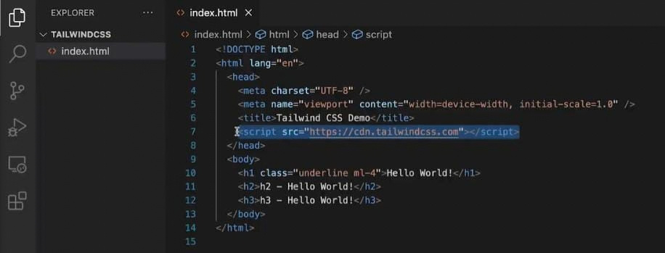
Tailwindcss
Using Tailwind through CDN
Flow:
Add CDN script → Tailwind loads in browser → use utility classes → UI gets styled
  CDN means Content Delivery Network. It lets us use Tailwind without installing or configuring it locally.
  Tailwind's Play CDN is mainly for development/testing and learning, not production.

Slide 12
Tailwind.css
Typography
Styling
Colours
Spacing
etc
note- 1 rem=16px
1 = 0.25 rem
4 = 1 rem

Slide 13
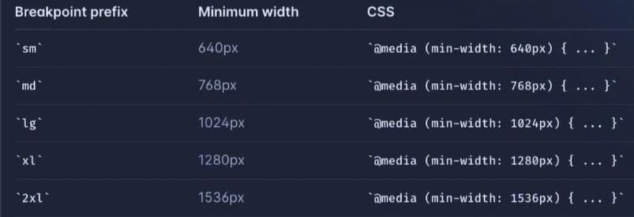
Breakpoints
Breakpoint = “At this screen width, change the styling.”
breakpoint as a screen-width checkpoint where your design changes
Screen-size
  text-sm → default/small screens
  md:text-lg → when screen reaches the md breakpoint, text becomes large
  lg:text-2xl → when screen reaches the lg breakpoint, text becomes even larger

Slide 14
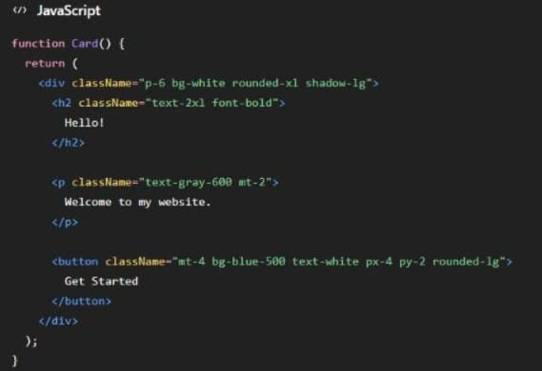
Tailwind in react.js
React allows us to write HTML-like UI code using JSX. JSX makes it easier to describe what our UI should look like, while Tailwind is used to style that UI.

Slide 15
UI COMPONENT LIBRARIES
Material UI (MUI)
React components based on Material Design
What it provides
MUI
  Ready-to-use React components
  Buttons, forms, cards, dialogs, tables, etc.
  Consistent Material Design
  Customizable
  Speeds up UI development
Ready-made\nReact components
Material Design → Faster UI development
Example
<Button variant="contained">\n Click Me\n</Button>
Build the UI, don't build every component
Client-Side Data Fetching
16

Slide 16
UI COMPONENT LIBRARIES
shadcn/ui
Reusable components with direct customization
What it provides
shadcn/ui
  Reusable components
  Highly customizable
  Open component code
  Works well with Tailwind CSS
  Commonly used with modern React/Next.js projects
Reusable + customizable
Direct code ownership → More control
Example
<Button variant="outline">\n Click Me\n</Button>
Customize the component to your needs
Client-Side Data Fetching
17

Slide 17
Introduction to Next.js
From JavaScript, to React, to Next.js - Building full web application
What is Next.js
Library vs. Framework
Why developers use it
  A framework built on the top of react
  Adds ready-made tools : rendering, optimization and backend support
  React(a library) : gives you tools - you decide the structure
  Next.js( a framework) : gives you structure AND Tools
  Faster page loading
  Built in support from SEO
  Less manual setup and configuration
  Built frontend and backend in one project

Slide 18


React vs. Next.js
next.js is built on react - it adds extra built in capabilities.
Feature | React | Next.js
Type | Library | Framework( built on react)
Routing | Set up manually | Built in support
Rendering | Client side by default | multiple options (CSR, SSR, SSG)
SEO | Needs extra setup | Easier built in support

Slide 19
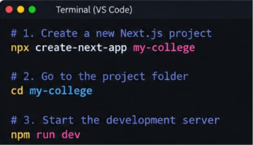
Set up of Next.js project
npx create-next-app my-college
creats the new next.js project with the name my-college.
1
2
cd my-college
Moves the terminal into the project folder
nmp run dev
start the development server
open http://localhost:3000 in your browser to see your site
3

Slide 20
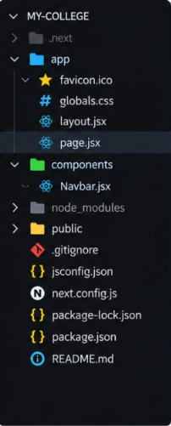
Next.js Project Structure
After creating the project, Next.js given a ready-to-use folder structure. We add components folder to keep reusable react components
Important Folders and files-
  app/ : contains pages and routes(Next.js uses the files inside this folder to organize routs)
  components/ : A folder we create to keep reusable React component(e.g. Navbar.jsx)
  public/ : Used to store static files like images, icons
  node_modules : this folder contains the libraries and packages required by the project
  package.json : contains project details and dependencies such as development command

Slide 21
How pages get Rendered in Next.js
Rendering means turning data and UI instruction into the page the user sees.
CSR
Client side Rendering-
The browser Downloads JavaScript and builts the page after it loads
Example- a dashboard you see after logging in
SSR
Server side Rendering-
The server prepares the full page freshly, for every single request
Example- a new homepage showing todays latest headline
SSG
Static site Generation-
Pages are prepared ahead of time, before any user even visits
Example- a blog post or an “About Us” page that rarely Changes

Slide 22
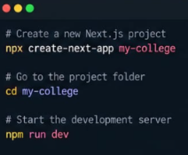
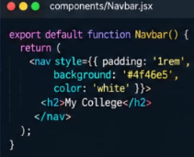
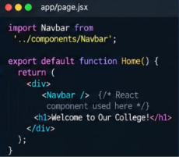
How React.js & Next.js work together
React.js
use inside
Next.js
create a next.js project
next.js give us a ready to use structure where we can write react components
Create a react component
we will write a simple react component (Same as we write react.js)
Use the component in page
we import and use the react component inside a next.js page
4

Slide 23

Bringing it all Together
What just Happened?
What appears in the browser?
  we created a next.js project
  we wrote a regular react component (Navbar.jsk)
  we Imported and used that component in a Next.js page
  Next.js rendered our react component as a part of the web application
7

Slide 24

Next.js App Router
& Client-Side Data Fetching
Routing, layouts & rendering in the App Router — then fetching data from the client with useEffect, SWR and React Query.
app/
layout.js
page.js
useSWR()
useQuery()
Frontend Libraries, Package Managers & Next.js
1

Slide 25
TODAY'S ROADMAP
What we'll cover
Part 1 — App Router
Part 2 — Data Fetching
1
2
  File-based routing basics
  App Router vs Pages Router
  Folder structure & special files
  Nested & dynamic routes
  Server vs Client Components
  Layouts, metadata & SEO
  Fetching with useEffect + fetch
  Handling loading & error states
  SWR & React Query
  Caching & revalidation
  Client-side vs server-side fetching
  Putting it together — a live example
Session 3 — Agenda
2

Slide 26
APP ROUTER · 01
File-based routing basics
  No route config file — the app/ folder structure IS the routing table.
  Each folder segment becomes part of the URL path.
  A folder becomes a visitable route only once it contains a page.js.
  Folders without a page.js are just organizational (or hold layouts).
app/page.js
/
app/about/page.js
/about
app/blog/page.js
/blog
app/contact/page.js
/contact
Next.js App Router Architecture
3

Slide 27
APP ROUTER · 02
App Router vs. legacy Pages Router
Pages Router
App Router
Root folder
pages/
app/
Data fetching
getServerSideProps / getStaticProps
async Server Components (fetch directly)
Default rendering
Client-rendered by default
Server Components by default
Layouts
Manual, per-page _app.js wrapper
Native, nested layout.js files
Status
Legacy — still supported
Recommended for new projects
Next.js App Router Architecture
4

Slide 28
APP ROUTER · 03
Folder structure & special files
layout.js
Shared UI (nav, footer) that wraps children and persists across navigation
app/
└
layout.js
page.js
The unique UI for this route segment — makes the folder publicly visitable
└
page.js
loading.js
Automatic loading/Suspense fallback shown while the segment loads
└
loading.js
error.js
Client error boundary that catches errors in this segment
└
error.js
not-found.js
Custom UI shown when notFound() is thrown or a route doesn't match
└
not-found.js
Next.js App Router Architecture
5

Slide 29
APP ROUTER · 04
Nested & dynamic routes
Folders nest to build nested URLs.
Square brackets [id] create a dynamic segment captured as a route parameter.
myapp.com/blog/123
app/
myapp.com/blog/123
blog/
page.js
params.id
evaluates to "123" — the same page can render different posts based on the URL.
[id]/
page.js
export default function Post({ params }) {
return <h1>Post #{params.id}</h1>;
}
Next.js App Router Architecture
6
Notes:
6

Slide 30
APP ROUTER · 05
Server vs. Client Components
Server Component
Client Component
S
C
Default in app/
Opt in with "use client"
  Default in app/
  Runs on the server
  Can fetch server-side data directly
  Cannot use useState, useEffect, or browser APIs
  Opt in with "use client"
  Required for hooks, event handlers & browser APIs
  Used when the UI needs client-side interactivity
// app/page.js (Server by default)
export default async function Page() {
const data = await getPosts();
return <PostList posts={data} />;
}
"use client";
import { useState } from "react";
export default function Counter() {
const [n, setN] = useState(0);
return <button onClick={() => setN(n+1)}>{n}</button>;
}
Next.js App Router Architecture
7
Notes:
7

Slide 31
When to use Cleint Side
APP ROUTER · 05
Need:
useState
useEffect
Event Handlers
Browser APIs
Interactive UI
Use "use client" only where client-side functionality is required.
Next.js App Router Architecture
7

Slide 32
APP ROUTER · 06
Shared layouts, metadata & SEO
Layouts wrap pages and persist across navigation
myapp.com/blog
// app/blog/page.js
export const metadata = {
title: "Blog — MyApp",
description: "Latest posts and updates",
};
layout.js — Navbar
page.js — {children}
Blog post content renders here and swaps as the user navigates —
the navbar above never re-mounts.
myapp.com/blog
Blog — MyApp
Latest posts and updates
↳ Browser tab title + search-result snippet, generated automatically
layout.js — Footer
No extra library needed — export metadata (or generateMetadata()) from any page.js or layout.js.
Next.js App Router Architecture
8

Slide 33
APP ROUTER · RESULT
Putting it together
app/
├─ layout.js // Navbar + Footer
├─ page.js // "/"
├─ about/
│ └─ page.js // "/about"
└─ blog/
├─ page.js // "/blog"
├─ loading.js // fallback UI
└─ [id]/
└─ page.js // "/blog/:id"
myapp.com/blog/123
Home
About
Blog
Post #123
Rendered by app/blog/[id]/page.js — the Navbar above came from the shared layout.js and did not re-render on navigation.
© 2026 MyApp — Footer (from layout.js)
Next.js App Router Architecture
9

Slide 34
PART 2
Client-Side Data Fetching
useEffect · loading & error states · SWR / React Query · caching & revalidation
Session 3 — Part 2
10

Slide 35
DATA FETCHING · 01
Fetching in Client Components
"use client";
import { useState, useEffect } from "react";
export default function Users() {
const [data, setData] = useState([);
useEffect(() => {
fetch("/api/users")
.then((res) => res.json())
.then(setData);
}, []);
return <UserList users={data} />;
}
1. Component renders
↓
2. Effect executes
↓
3. HTTP request is sent
↓
4. Server returns response
↓
5. JSON is parsed
↓
6. State is updated
↓
7. Component re-renders
1
2
3
4
  This pattern uses useEffect, so the component must be a Client Component.
  The empty dependency array [] means it runs once, on mount.
  Until the fetch resolves, data is null — the UI must handle that.
  Every re-fetch, cache and race-condition edge case is on you to manage manually.
Component
mounts
useEffect
fires
fetch()
called
setState
updates UI
Client-Side Data Fetching
11

Slide 36
DATA FETCHING · 02
Handling loading & error states
const [data, setData] = useState(null);
const [loading, setLoading] = useState(true);
const [error, setError] = useState(null);
useEffect(() => {
fetch("/api/users").then(r => r.json()).then(setData).catch(setError).finally(() => setLoading(false));
}, []);
Three UI states, three outcomes
myapp.com/users
myapp.com/users
myapp.com/users
⟳ Loading…
⚠ Something went wrong
✓ 3 users found
loading === true
error !== null
data loaded
Client-Side Data Fetching
12

Slide 37
DATA FETCHING · 03
SWR & React Query (TanStack Query)
Data-fetching libraries reduce manual state management and add caching, revalidation and refetching.
// Manual — useEffect approach
const [data, setData] = useState(null);
const [loading, setLoading] = useState(true);
const [error, setError] = useState(null);
useEffect(() => {
fetch("/api/users")
.then(r => r.json())
.then(setData)
.catch(setError)
.finally(() => setLoading(false));
}, []);
// SWR — one hook does it all
import useSWR from "swr";
const { data, error, isLoading } = useSWR(
"/api/users",
(url) => fetch(url).then(r => r.json())
);
Automatic caching
Background revalidation
Built-in retry on error
De-duplicated requests
Client-Side Data Fetching
13

Slide 38
DATA FETCHING · 04
Caching, revalidation & where to fetch
Caching & revalidation timeline
Fetch
& cache
Serve from
cache (fast)
Tab refocused /
interval elapses
Revalidate
in background
UI updates
if changed
Client-side vs. server-side fetching in Next.js
Client-side fetch (this session)
Server-side fetch (preview)
Runs where
In the browser, after page load
On the server, before HTML is sent
SEO / crawlers
Content is fetched after the initial page load
Content can be included in the initial response
Best for
Search, filters, dashboards, live interactions
Initial content, server-only resources, SEO-sensitive pages
Client-Side Data Fetching
14

Slide 39
FINAL EXAMPLE
From folder to fetched data
Key takeaways
myapp.com/users
Users
  The app/ folder structure defines your routes — page.js makes a segment visitable.
  layout.js, loading.js and error.js give you shared UI, fallbacks and error handling for free.
  Components are Server by default; add "use client" only where interactivity is needed.
  useEffect + fetch works, but SWR / React Query remove the boilerplate and add caching.
  Client fetching is for interactive data; server fetching wins for SEO-critical initial content.
A
Aditi Rao
M
Marco Bell
Y
Yuki Tanaka
Rendered with useSWR("/api/users") — cached, revalidated, no manual loading/error state.
Session 3 — Summary
15

Slide 40


QUESTION
01
A Next.js page needs to show a list of products immediately when the page is rendered, and the data comes from a database that should never be accessed directly by the browser.
Which approach is most appropriate?
A. Fetch the database directly from a Client Component
B. Fetch the data on the server using a Server Component
C. Store the database credentials in useState()
D. Use useEffect() to connect directly to the database

Slide 41
QUESTION
02
What does app/blog/[id]/page.js allow you to create?
A. Only /blog/id
B. Multiple routes like /blog/1, /blog/2, etc.
C. An API endpoint for the database
D. A shared layout for all pages

Slide 42
QUESTION
03
what is the primary use of public folder in next.js project?
A. To store images and icon
B.To store all react component
C. To store home page components
D. all of the above

Slide 43
QUESTION
04
Why can a project still be set up even if the node_modules folder is missing?
A. node_modules is automatically downloaded from GitHub
B. package.json and package-lock.json contain the information needed to reinstall the dependencies
C. React does not require node_modules
D.package-lock.json contains the entire node_modules folde

Slide 44
QUESTION
05
Which of the following will NOT happen automatically?
A. express gets added to package.json
B. express gets installed inside node_modules
C.package-lock.json gets updated
D. The source code of your entire project gets uploaded to npm

